Slide 1
Artificial Neural Networks
Prof. Dr. A K M Akhtar Hossain
Dept. Of CSE, RU

Slide 2
Biological inspirations
Some numbers…
  The human brain contains about 10¹⁴ nerve cells (neurons)
  Each neuron is connected to the others through 10⁴ synapses
Properties of the brain
  It can learn, reorganize itself from experience
  It adapts to the environment
  It is robust and fault tolerant

Slide 3
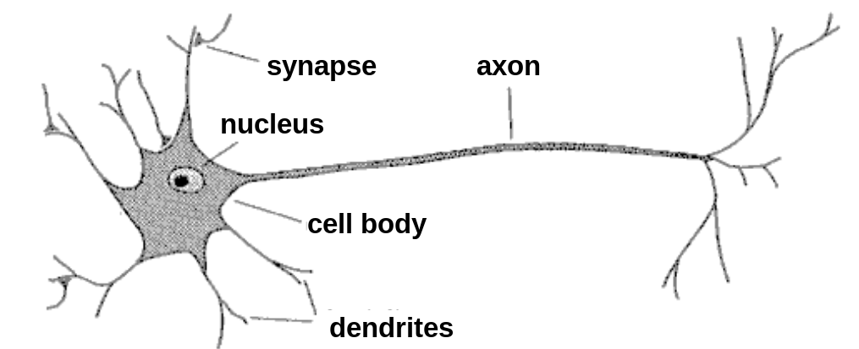
Biological Neuron
A neuron has
  A branching input (dendrites which receive input signals.)
  A branching output (the axon, which send output signals.)
The information circulates from the dendrites to the axon via the cell body.
Dendrites receive input from sensory organs such as the eyes or ears and from axons of other neurons.
Axons send output to organs such as muscles and to dendrites of other neurons.

Slide 4


An early attempt to form an abstract mathematical model of a neuron was by McCulloch and Pitts in 1943.
Their model …..
receives a finite number of inputs x₁ , x₂, . . . . x_{M}
  Computes the weighted sum ,
  using the weights ω₁ , ω₂ , . . . . . ω_{M}

Slide 5
The McCulloch-Pitts model of the neuron
Thresholds s and outputs 0 or 1 depending on whether the weighted sum is less than or greater than a given threshold value T.
The combination of summation and thresholding is called a node in an artificial neural network.
Node inputs with positive weights are excitory and node inputs with negative weights are called inhibitory.

Slide 6
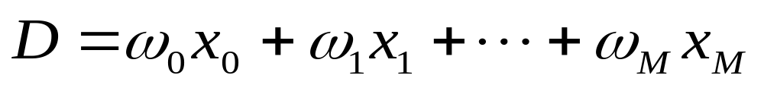
The McCulloch-Pitts model of the neuron
The action of the model neuron is output 1 if
(1)
and 0 otherwise.
We rewrite Eq.(1) as the sum
(2)
Where, ω₀ = -T and x₀ =1.

Slide 7
The McCulloch-Pitts model of the neuron
Output 1 if D>0 and
Output 0 if D≤0.
The weight ω₀ in Eq.(1) is called the bias weight.

Slide 8
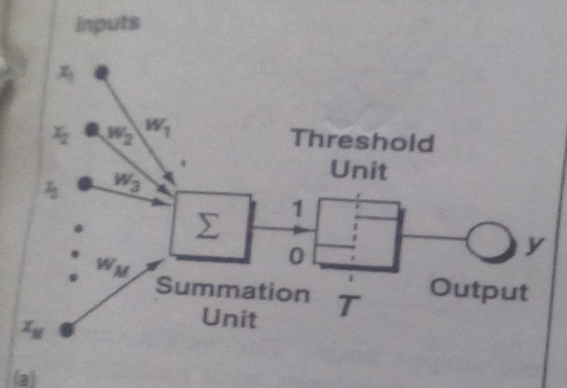
The McCulloch-Pitts model of the neuron

Slide 9
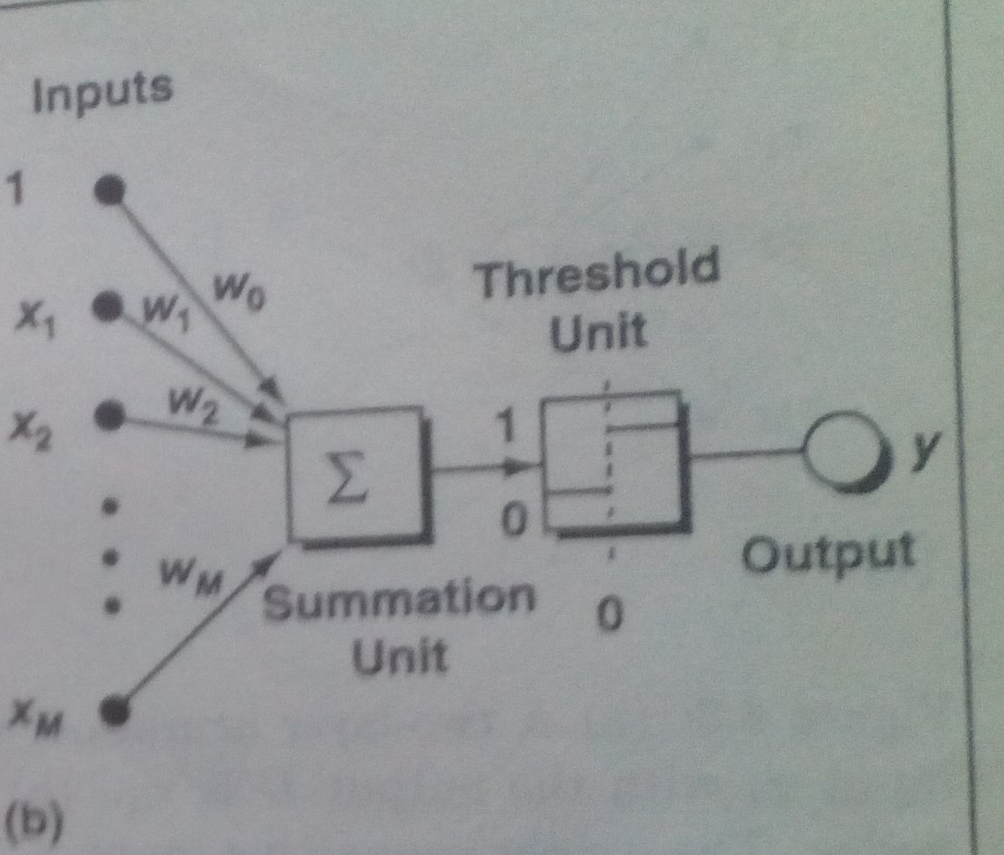
The McCulloch-Pitts model of the neuron
Model of a neuron with a bias weight.

Slide 10

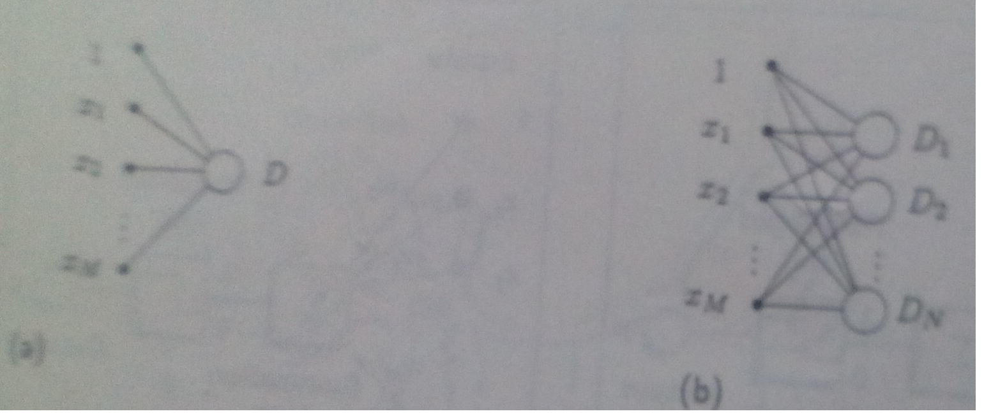
Figure(a). A two-layer neural net with one output. Fig.(b). A two-layer neural net with multiple output.

Slide 11

Artificial neural network (ANN) is a machine learning approach that models human brain and consists of a number of artificial neurons.
Neuron in ANNs tend to have fewer connections than biological neurons.
Each neuron in ANN receives a number of inputs.
An activation function is applied to these inputs which results in output value of the neuron(activation level of neuron ).
Knowledge about the learning task is given in the form of examples called training examples.

Slide 12
Contd..
An Artificial Neural Network is specified by:
  neuron model: the information processing unit of the NN,
  an architecture: a set of neurons and links connecting neurons. Each link has a weight,
  a learning algorithm: used for training the NN by modifying the weights in order to model a particular learning task correctly on the training examples.
The aim is to obtain a NN that is trained and generalizes well.
It should behaves correctly on new instances of the learning task.

Slide 13

• Signal processing: suppress line noise, with adaptive echo canceling, blind source separation.
• Robotics - navigation, vision recognition
• Pattern recognition, i.e. recognizing handwritten characters
• Medicine: storing medical records based on case information
• Vision: face recognition , edge detection, visual search engines
• Financial Applications: time series prediction, stock market prediction
• Data Compression: speech signal, image, e.g. faces
• Game Playing: chess, go, ...
Process identification
Process control
Optical character recognition
Adaptative filtering
Etc…

Slide 14

The VC dimension of neural networks is unclear. This is very important when you want to consider how good a solution might be.
Neural networks cannot be retrained. If you add data later, this is almost impossible to add to an existing network.
Handling of time series data in neural networks is a very complicated topic.
Need a large dataset
It is not possible to explain how the results were calculated in any meaningful way.
There are many parameters to be set in a neural network and optimizing the network can be challenging, especially to avoid overtraining.

Slide 15

1. They can work fine in case of incomplete information
2. They do not require knowledge of the algorithm solving the
problem (automatic learning)
3. Process information in a highly parallel way
4. They can generalize (generalize to cases unknown)
5. They are resistant to partial damage
6. They can perform associative memory (associative - like working memory in humans) as opposed to addressable memory (typical for classical computers)
7. Faster execution.
8. Reduced number of weights
    Require fewer examples in the training set
    Faster learning

Slide 16
A neural network can perform tasks that a linear program can not.
• When an element of the neural network fails, it can continue without any problem by their parallel nature.
• A neural network learns and does not need to be reprogrammed.
• It can be implemented in any application.
• It can be implemented without any problem.

Slide 17

Determination of pertinent inputs
Collection of data for the learning and testing phase of the neural network
Finding the optimum number of hidden nodes
Estimate the parameters (Learning)
Evaluate the performances of the network
IF performances are not satisfactory then review all the precedent points

Slide 18

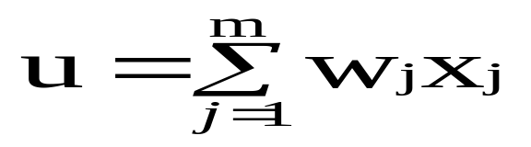

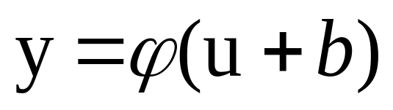
The neuron is the basic information processing unit of a NN. It consists of:
  A set of links, describing the neuron inputs, with weights W₁, W₂, …, W_{m}
  An adder function (linear combiner) for computing the weighted sum of the inputs:
  (real numbers)
  Activation function for limiting the amplitude of the neuron output. Here ‘b’ denotes bias.

Slide 19
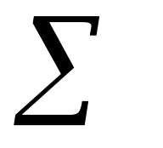
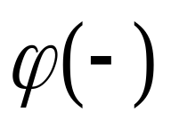

The Neuron Diagram
Bias
b
x₁
w₁
Activation
function
Induced
Field
v
Output
y
Input
values
x₂
w₂
Summing
function
x_{m}
w_{m}
weights

Slide 20

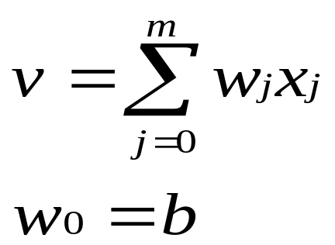
The bias b has the effect of applying a transformation to the weighted sum u
        v = u + b
The bias is an external parameter of the neuron. It can be modeled by adding an extra input.
v is called induced field of the neuron

Slide 21

The operation of an artificial neural network is to sum up the product of the associated weight and the input signal and produce an output or activation function. For the input unit this activation function is the identity function. The neuron of a particular layer gets the same type of activation function. In almost all cases non- linear activation functions are used.
The various types of activation functions used in a neural network are binary step function, ramp function, binary sigmoid functions and Gaussian function.

Slide 22

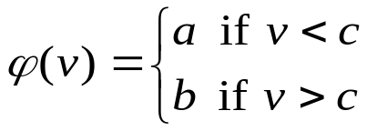
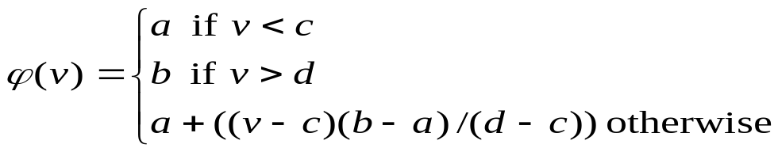
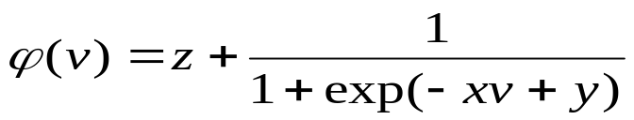
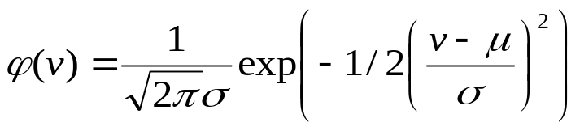
The choice of activation function determines the neuron model.
Examples:
step function:
ramp function:
sigmoid function with z,x,y parameters
Gaussian function:

Slide 23

The output is set at one of two levels, depending on whether the total input is greater than or less than some threshold value.
b
a
c

Slide 24

The output is set at one of three levels, depending on whether the total input is greater than or less than or between greater than and less than some threshold value.
b
a
c d

Slide 25

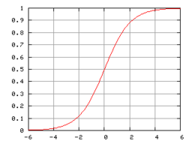
The sigmoid function consists of 2 functions, logistic and tangential. The values of logistic function range from 0 and 1 and -1 to +1 for tangential function.

Slide 26

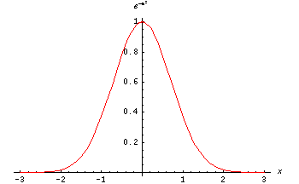
The Gaussian function is the probability function of the normal distribution. Sometimes also called the frequency curve.

Slide 27
Network Architectures
Three different classes of network architectures
  single-layer feed-forward
  multi-layer feed-forward
  recurrent
The architecture of a neural network is linked with the learning algorithm used to train

Slide 28
Single Layer Feed-forward
Input layer
of
source nodes
Output layer
of
neurons

Slide 29
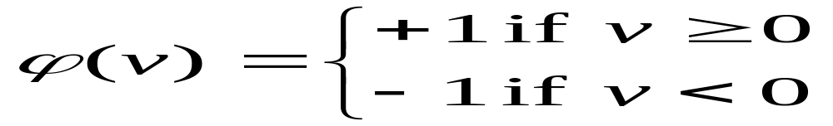
Perceptron: Neuron Model
(Special form of single layer feed forward)
The perceptron was first proposed by Rosenblatt (1958) is a simple neuron that is used to classify its input into one of two categories.
A perceptron uses a step function that returns +1 if weighted sum of its input ≥ 0 and -1 otherwise
b (bias)
x₁
w₁
v
y
x₂
w₂
ϕ(v)
w_{n}
x_{n}

Slide 30
Perceptron for Classification
The perceptron is used for binary classification.
First train a perceptron for a classification task.
  Find suitable weights in such a way that the training examples are correctly classified.
  Geometrically try to find a hyper-plane that separates the examples of the two classes.
The perceptron can only model linearly separable classes.
When the two classes are not linearly separable, it may be desirable to obtain a linear separator that minimizes the mean squared error.
Given training examples of classes C₁, C₂ train the perceptron in such a way that :
  If the output of the perceptron is +1 then the input is assigned to class C₁
  If the output is -1 then the input is assigned to C₂

Slide 31
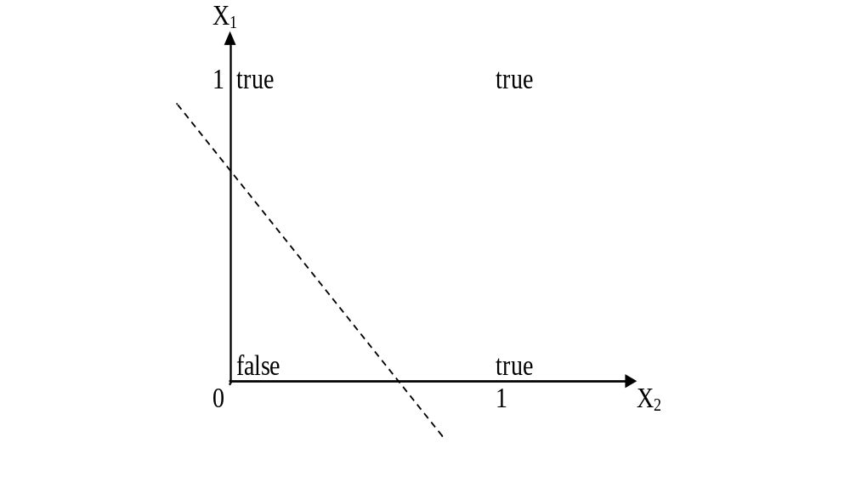
Boolean function OR – Linearly separable

Slide 32
Learning Process for Perceptron
Initially assign random weights to inputs between -0.5 and +0.5
Training data is presented to perceptron and its output is observed.
If output is incorrect, the weights are adjusted accordingly using following formula.
wi ← wi + (a* xi *e), where ‘e’ is error produced and ‘a’ (-1 < a < 1) is learning rate
  ‘a’ is defined as 0 if output is correct, it is +ve, if output is too low and –ve, if output is too high.
  Once the modification to weights has taken place, the next piece of training data is used in the same way.
  Once all the training data have been applied, the process starts again until all the weights are correct and all errors are zero.
  Each iteration of this process is known as an epoch.

Slide 33
Example: Perceptron to learn OR function
Initially consider w1 = -0.2 and w2 = 0.4
Training data say, x1 = 0 and x2 = 0, output is 0.
Compute y = Step(w1*x1 + w2*x2) = 0. Output is correct so weights are not changed.
For training data x1=0 and x2 = 1, output is 1
Compute y = Step(w1*x1 + w2*x2) = 0.4 = 1. Output is correct so weights are not changed.
Next training data x1=1 and x2 = 0 and output is 1
Compute y = Step(w1*x1 + w2*x2) = - 0.2 = 0. Output is incorrect, hence weights are to be changed.
Assume a = 0.2 and error e=1
wi = wi + (a * xi * e) gives w1 = 0 and w2 =0.4
With these weights, test the remaining test data.
Repeat the process till we get stable result.

Slide 34
Perceptron: Limitations
The perceptron can only model linearly separable functions,
  those functions which can be drawn in 2-dim graph and single straight line separates values in two part.
Boolean functions given below are linearly separable:
  AND
  OR
  COMPLEMENT
It cannot model XOR function as it is non linearly separable.
  When the two classes are not linearly separable, it may be desirable to obtain a linear separator that minimizes the mean squared error.

Slide 35
XOR – Non linearly separable function
A typical example of non-linearly separable function is the XOR that computes the logical exclusive or..
This function takes two input arguments with values in {0,1} and returns one output in {0,1},
Here 0 and 1 are encoding of the truth values false and true,
The output is true if and only if the two inputs have different truth values.
XOR is non linearly separable function which can not be modeled by perceptron.
For such functions we have to use multi layer feed-forward network.

Slide 36
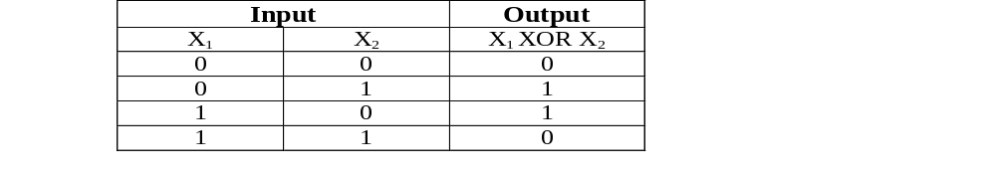
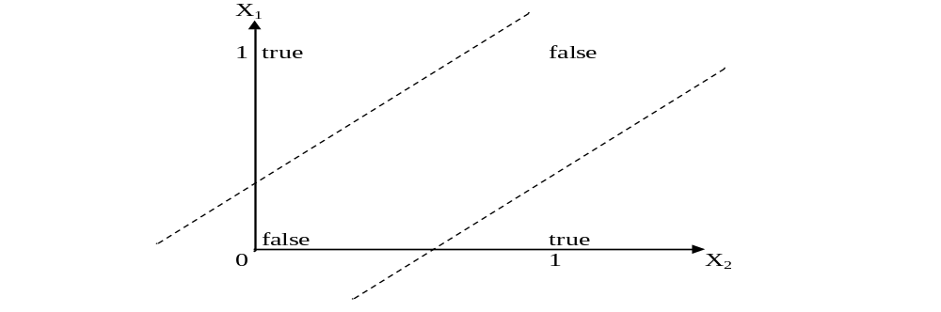
These two classes (true and false) cannot be separated using a line. Hence XOR is non linearly separable.

Slide 37
FFNN is a more general network architecture, where there are hidden layers between input and output layers.
Hidden nodes do not directly receive inputs nor send outputs to the external environment.
FFNNs overcome the limitation of single-layer NN.
They can handle non-linearly separable learning tasks.
Input
layer
Output
layer
Hidden Layer
3-4-2 Network

Slide 38

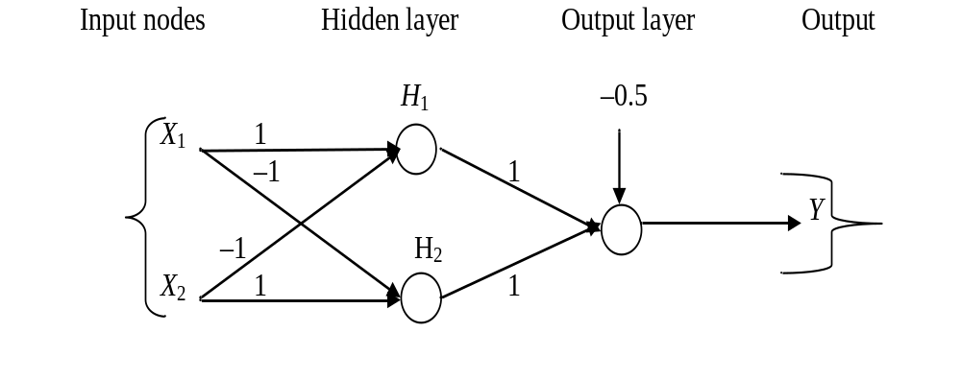
The ANN for XOR has two hidden nodes that realizes this non-linear separation and uses the sign (step) activation function.
Arrows from input nodes to two hidden nodes indicate the directions of the weight vectors (1,-1) and (-1,1).
The output node is used to combine the outputs of the two hidden nodes.

Slide 39
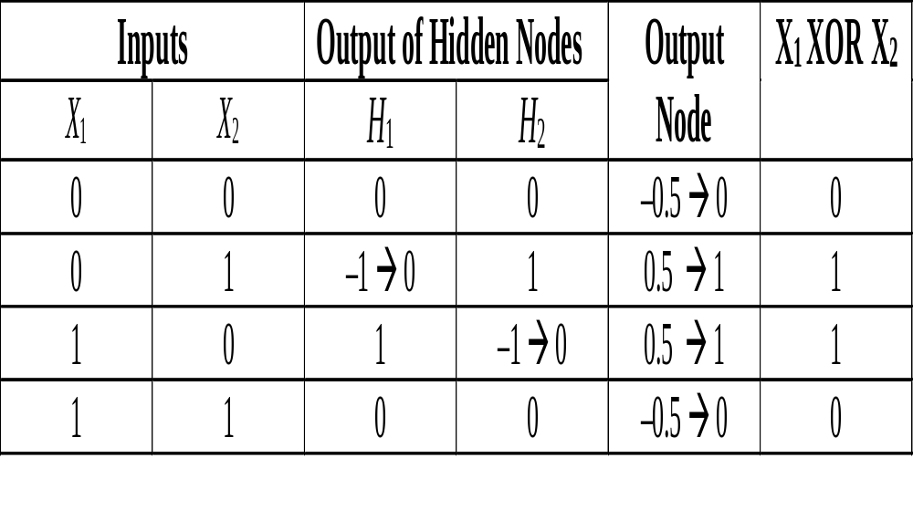
Since we are representing two states by 0 (false) and 1 (true), we will map negative outputs (–1, –0.5) of hidden and output layers to 0 and positive output (0.5) to 1.

Slide 40
The classical learning algorithm of FFNN is based on the gradient descent method.
For this reason the activation function used in FFNN are continuous functions of the weights, differentiable everywhere.
The activation function for node i may be defined as a simple form of the sigmoid function in the following manner:
where A > 0, V_{i} = ∑ W_{ij} * Y_{j} , such that W_{ij} is a weight of the link from node i to node j and Y_{j} is the output of node j.

Slide 41

The Backpropagation algorithm learns in the same way as single perceptron.
It searches for weight values that minimize the total error of the network over the set of training examples (training set).
Backpropagation consists of the repeated application of the following two passes:
  Forward pass: In this step, the network is activated on one example and the error of (each neuron of) the output layer is computed.
  Backward pass: in this step the network error is used for updating the weights. The error is propagated backwards from the output layer through the network layer by layer. This is done by recursively computing the local gradient of each neuron.

Slide 42

Back-propagation training algorithm
Backpropagation adjusts the weights of the NN in order to minimize the network total mean squared error.
Network activation
Forward Step
Error propagation
Backward Step

Slide 43
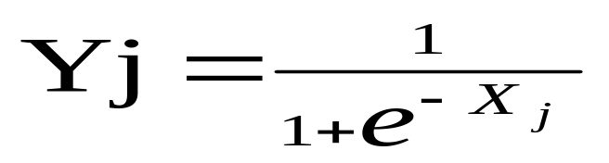
Contd..
Consider a network of three layers.
Let us use i to represent nodes in input layer, j to represent nodes in hidden layer and k represent nodes in output layer.
w_{ij} refers to weight of connection between a node in input layer and node in hidden layer.
The following equation is used to derive the output value Yj of node j
where, X_{j} = ∑ x_{i} . w_{ij} - θ_{j} , 1≤ i ≤ n; n is the number of inputs to node j, and θ_{j} is threshold for node j

Slide 44
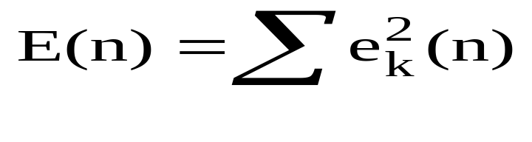
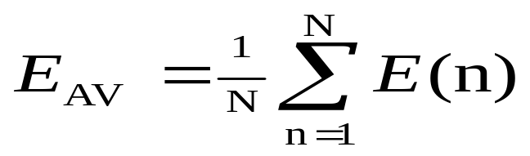
Total Mean Squared Error
The error of output neuron k after the activation of the network on the n-th training example (x(n), d(n)) is:
    e_{k}(n) = d_{k}(n) – y_{k}(n)
The network error is the sum of the squared errors of the output neurons:
The total mean squared error is the average of the network errors of the training examples.

Slide 45

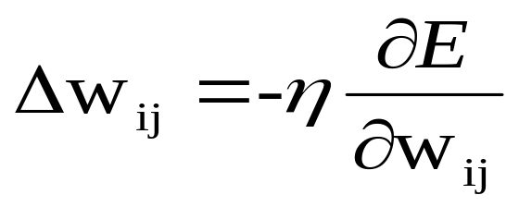
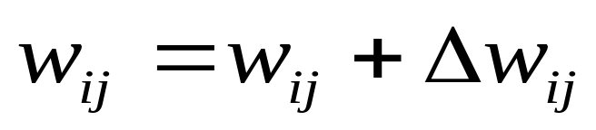
The Backpropagation weight update rule is based on the gradient descent method:
  It takes a step in the direction yielding the maximum decrease of the network error E.
  This direction is the opposite of the gradient of E.
Iteration of the Backpropagation algorithm is usually terminated when the sum of squares of errors of the output values for all training data in an epoch is less than some threshold such as 0.01

Slide 46

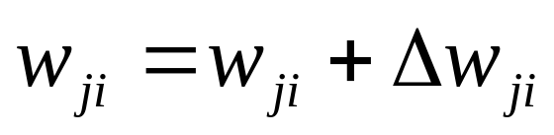
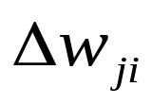
n=1;
initialize weights randomly;
while (stopping criterion not satisfied or n <max_iterations)
  for each example (x,d)
  - run the network with input x and compute the output y
  - update the weights in backward order starting from those of the output layer:
  with computed using the (generalized) Delta rule
  end-for
n = n+1;
end-while;

Slide 47

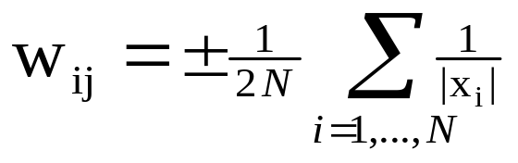
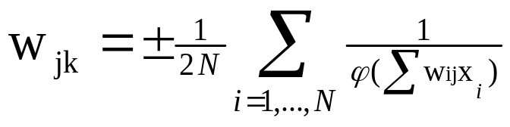
In general, initial weights are randomly chosen, with typical values between -1.0 and 1.0 or -0.5 and 0.5.
If some inputs are much larger than others, random initialization may bias the network to give much more importance to larger inputs.
In such a case, weights can be initialized as follows:
For weights from the input to the first layer
For weights from the first to the second layer

Slide 48

During learning phase,
  a recurrent network feeds its inputs through the network, including feeding data back from outputs to inputs
  process is repeated until the values of the outputs do not change.
This state is called equilibrium or stability
Recurrent networks can be trained by using back-propagation algorithm.
In this method, at each step, the activation of the output is compared with the desired activation and errors are propagated backward through the network.
Once this training process is completed, the network becomes capable of performing a sequence of actions.

Slide 49

A Hopfield network is a kind of recurrent network as output values are fed back to input in an undirected way.
  It consists of a set of N connected neurons with weights which are symmetric and no unit is connected to itself.
  There are no special input and output neurons.
  The activation of a neuron is binary value decided by the sign of the weighted sum of the connections to it.
  A threshold value for each neuron determines if it is a firing neuron.
  A firing neuron is one that activates all neurons that are connected to it with a positive weight.
  The input is simultaneously applied to all neurons, which then output to each other.
  This process continues until a stable state is reached.

